Slide 1

Machine Learning with a Heart (Predicting Heart Disease)
Team6
Paul Vincent Nonat
Paulino Salmon III
Gerald Ivan Sotelo
HOSTED BY DRIVENDATA
https://www.drivendata.org/competitions/54/machine-learning-with-a-heart/page/108/

Slide 2

Competition Goal
The goal is to predict the binary class heart_disease_present, which represents whether or not a patient has heart disease:
0 represents no heart disease present
1 represents heart disease present
Ranking is Based on Logarithmic Loss

Slide 3
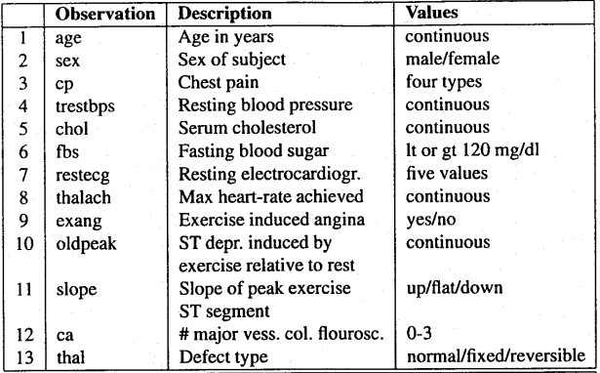
Dataset (Cleveland Heart Disease Database)

Slide 4
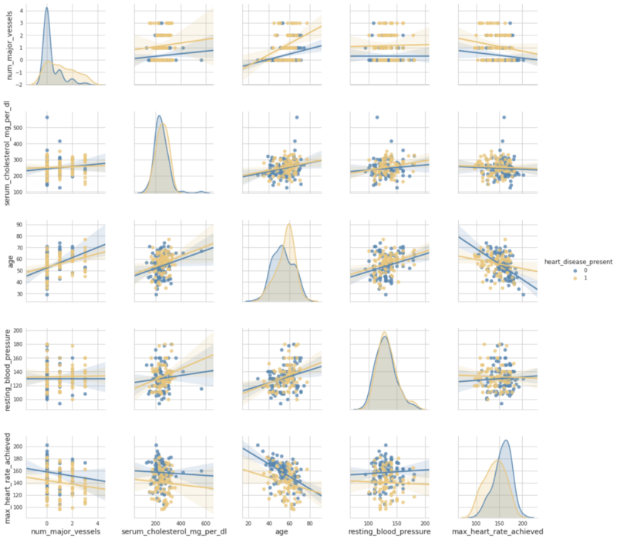
Data Exploration using pair plot from seaboard library

Slide 5
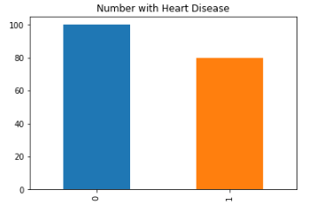
Data Exploration using pair plot from seaboard library

Slide 6
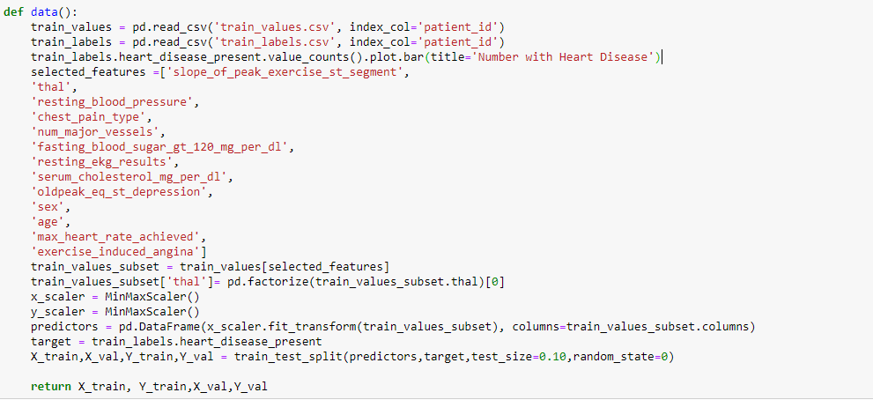
Dataset Preparation

Slide 7
Model Selection
1. User-Defined MLP Model
2. Hyperparameterized MLP Model via Hyperopt

Slide 8
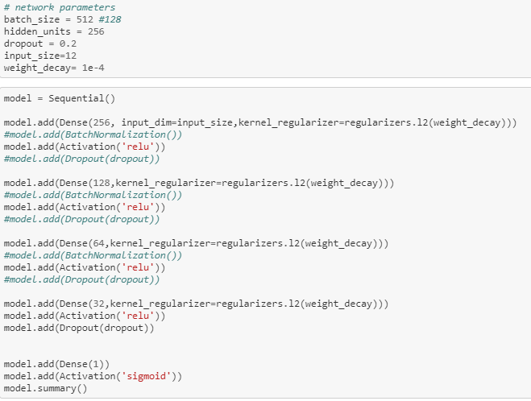
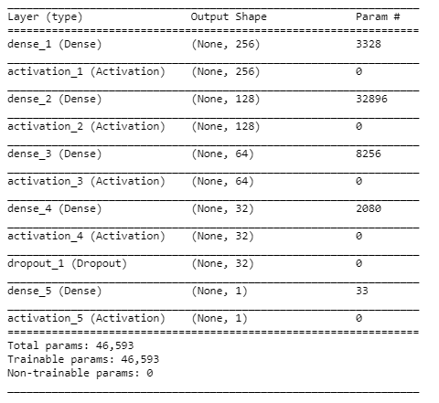
User-Defined MLP Model

Slide 9
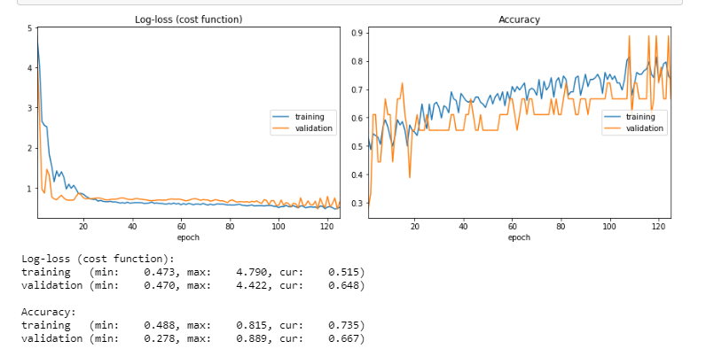
Result

Slide 10
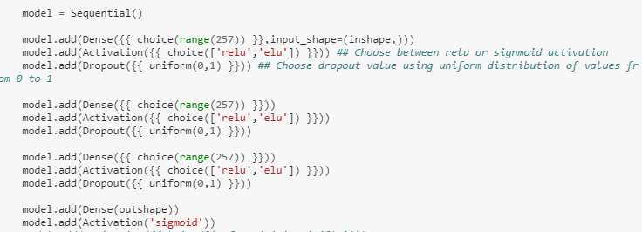
Hyper parameter Tuning via HyperOpt
http://hyperopt.github.io/hyperopt/

Slide 11
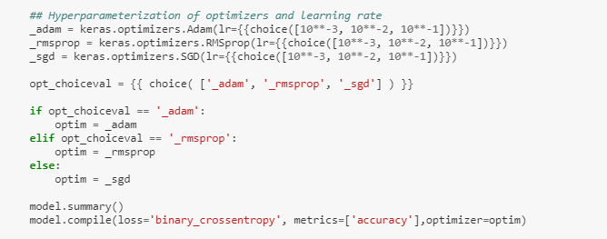
Hyper parameter Tuning via HyperOpt

Slide 12
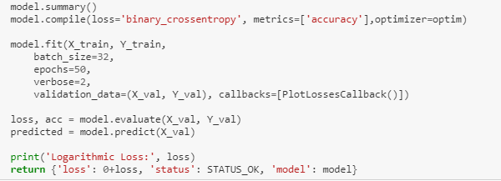
Hyper parameter Tuning via HyperOpt

Slide 13
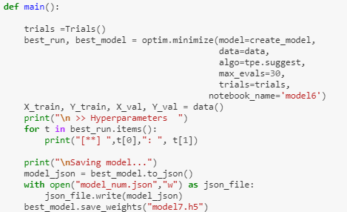
Hyper parameter Tuning via HyperOpt

Slide 14
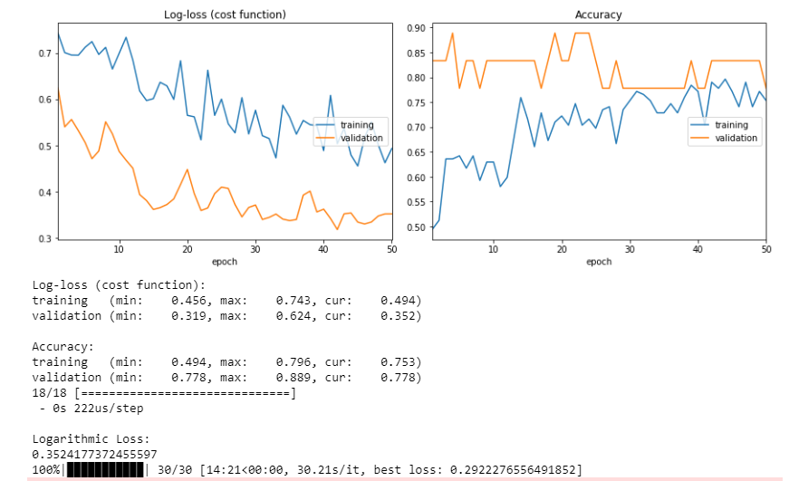
Hyper parameter Tuning Result

Slide 15
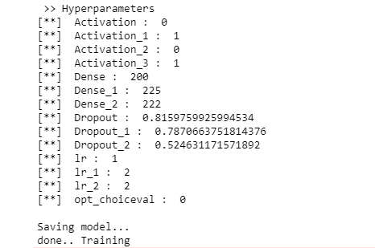
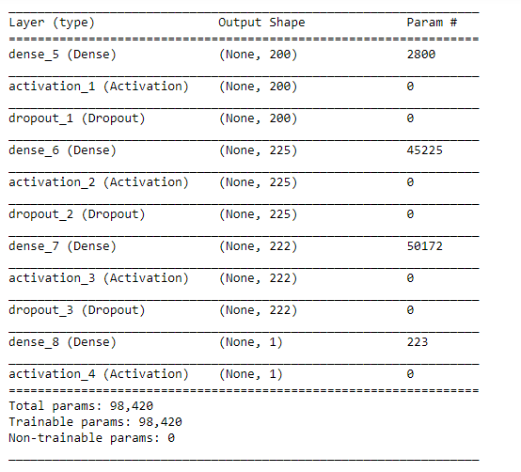
Best Model according to Hyperopt

Slide 16
Final Result and Ranking
User-Defined MLP Model
Rank – 303 As of 03/15/2019 12:45 PM
2. Hyperparameterized MLP Model via Hyperopt
Rank - 257

Slide 17
https://github.com/paul028/Group6_competitionproject

